Slide 1



VERY DEMURE’s
DATA SCIENCE
PROJECT

Slide 2




VERY DEMURE’S TEAM
Panatchakorn Tirachuli
6638145521
Pimmada Aphiwetsa
6638166721
Sunatcha Kulaputana
6638252021
Anunya Tangrungruangchai
6638264521

Slide 3








OUR PROJECT FLOW
DATA Module
AI Module
Visualization
classify and
vectorize
TF - IDF
Data
train + test
748
+
LOGISTIC
REGRESSION
MODEL
predict subject area
300

Slide 4
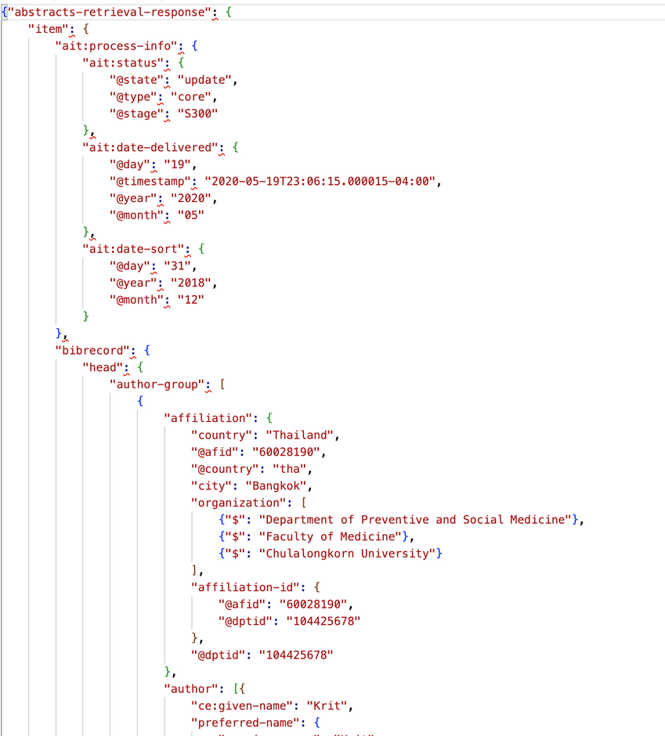
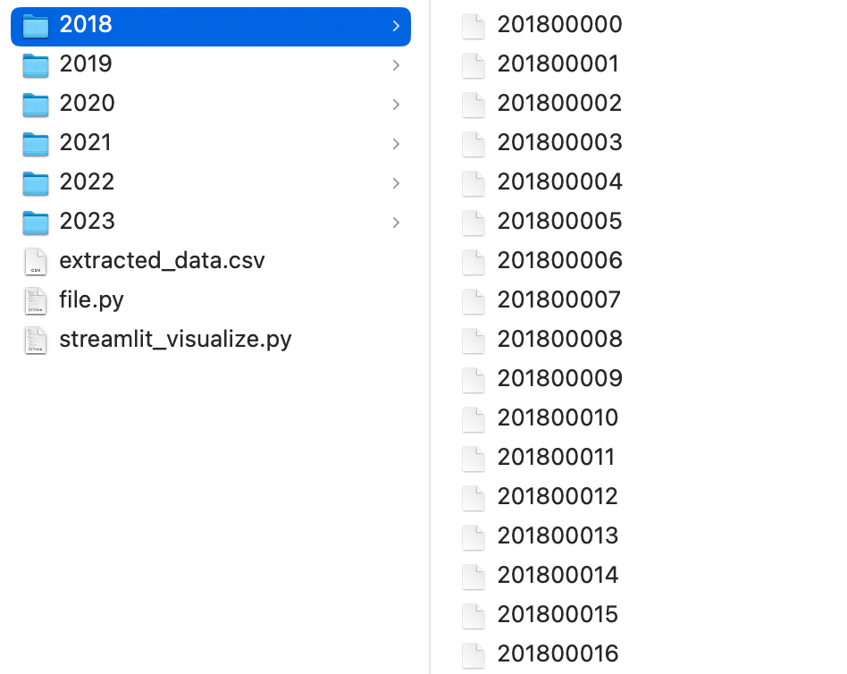
EXTRACTING DATA

Slide 5
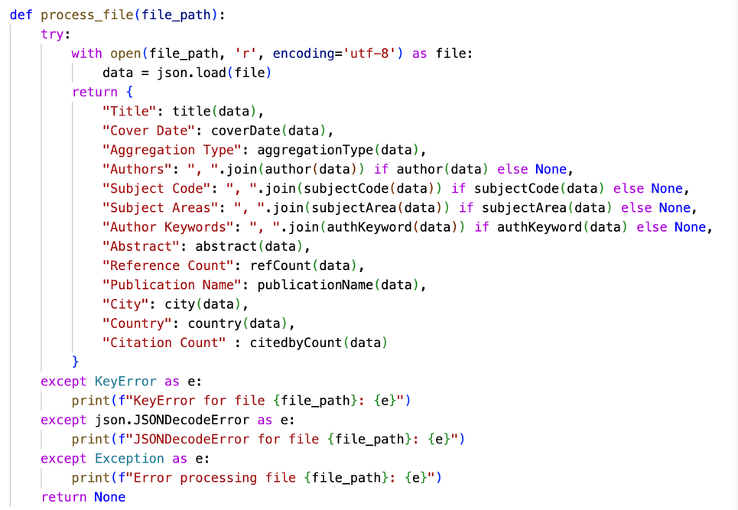
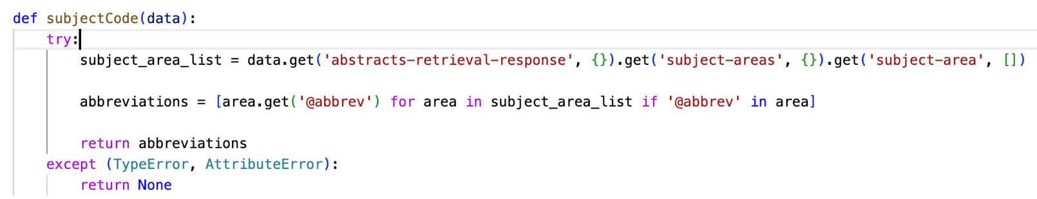
Example Function
Error Handling

Slide 6
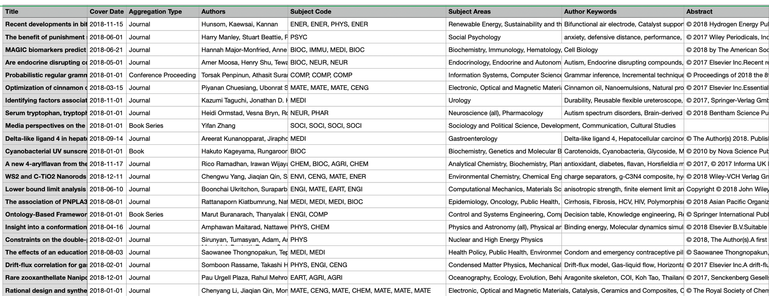
SAVE TO CSV

Slide 7
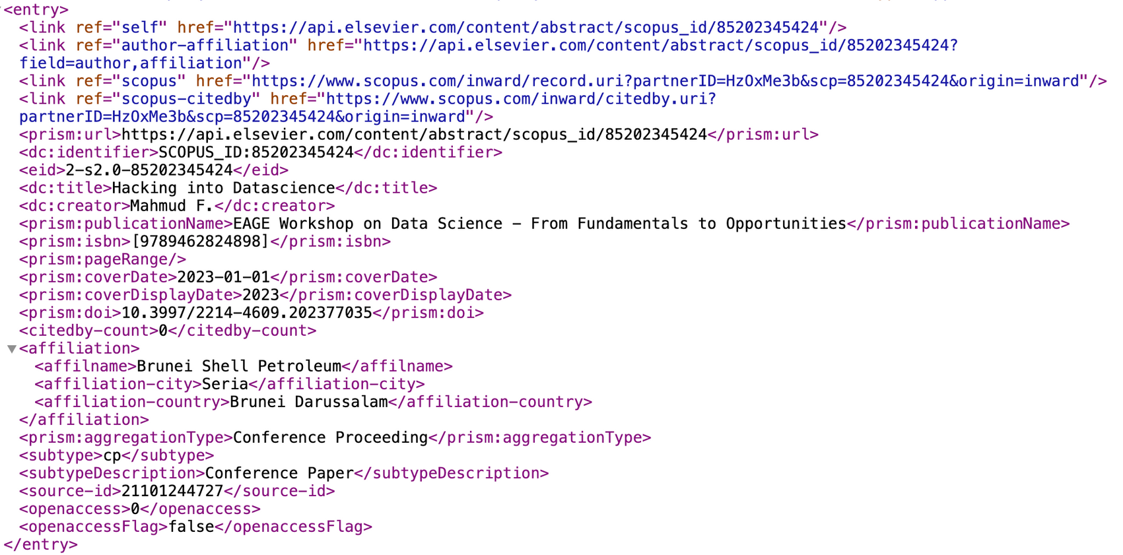
SCOPUS API
query = “Data Science”
No abstract!

Slide 8
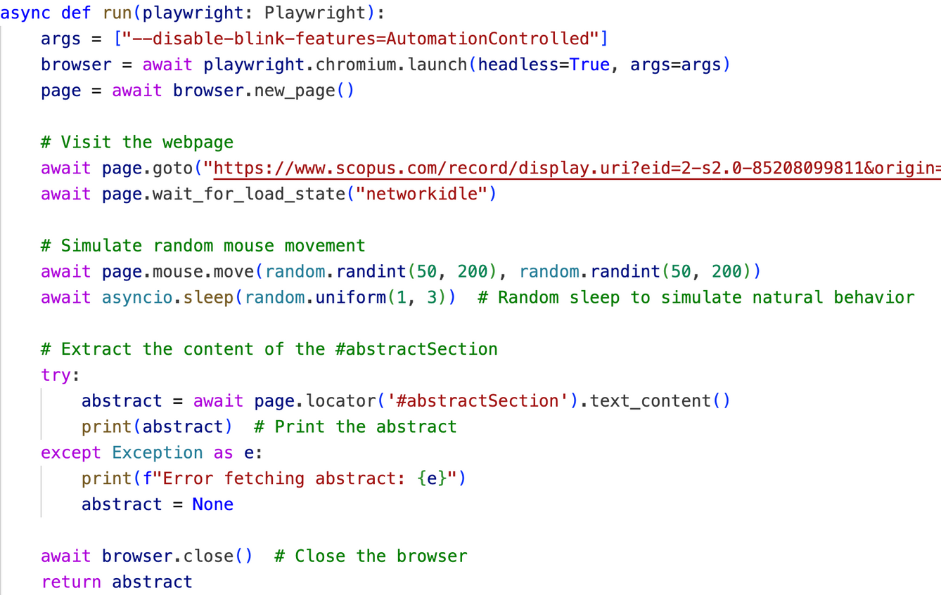
FIRST TRIAL “PLAYWRIGHT”

Slide 9

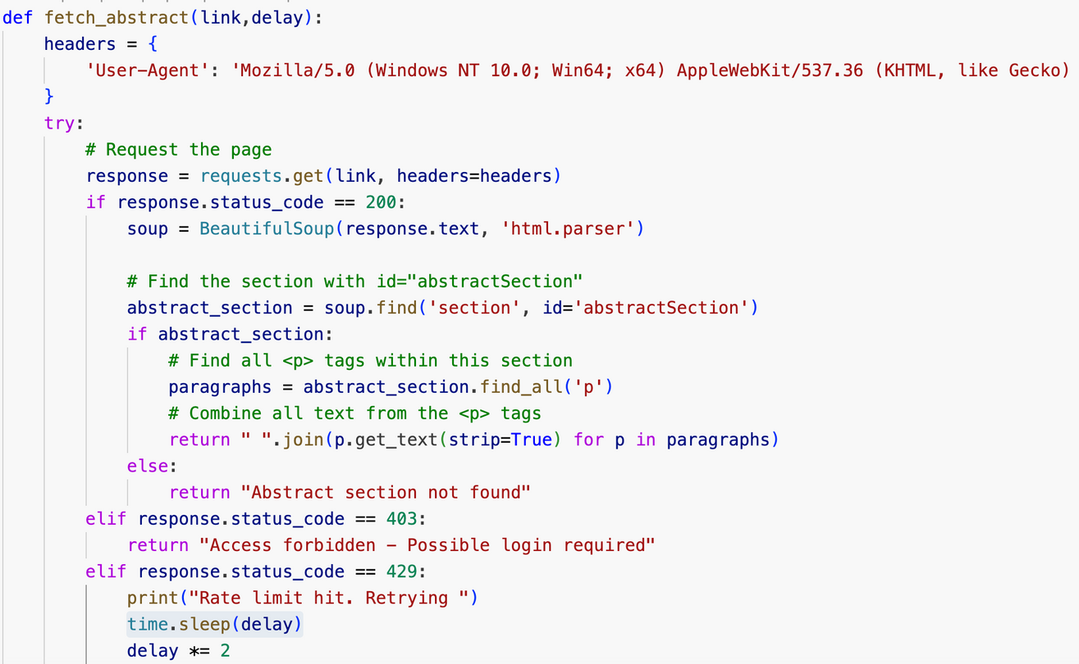
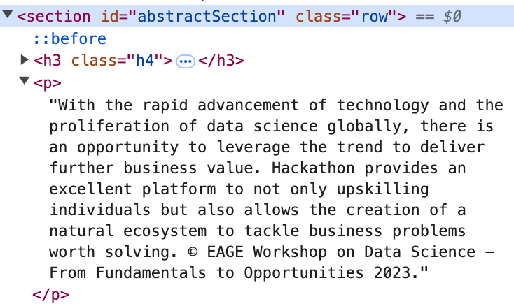
BEAUTIFULSOUP

Slide 10
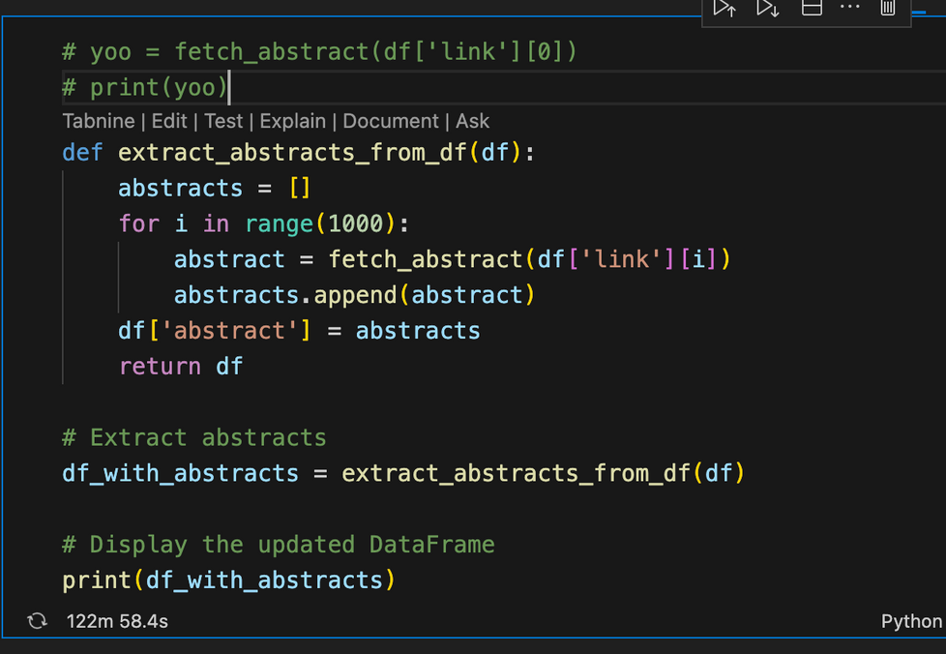
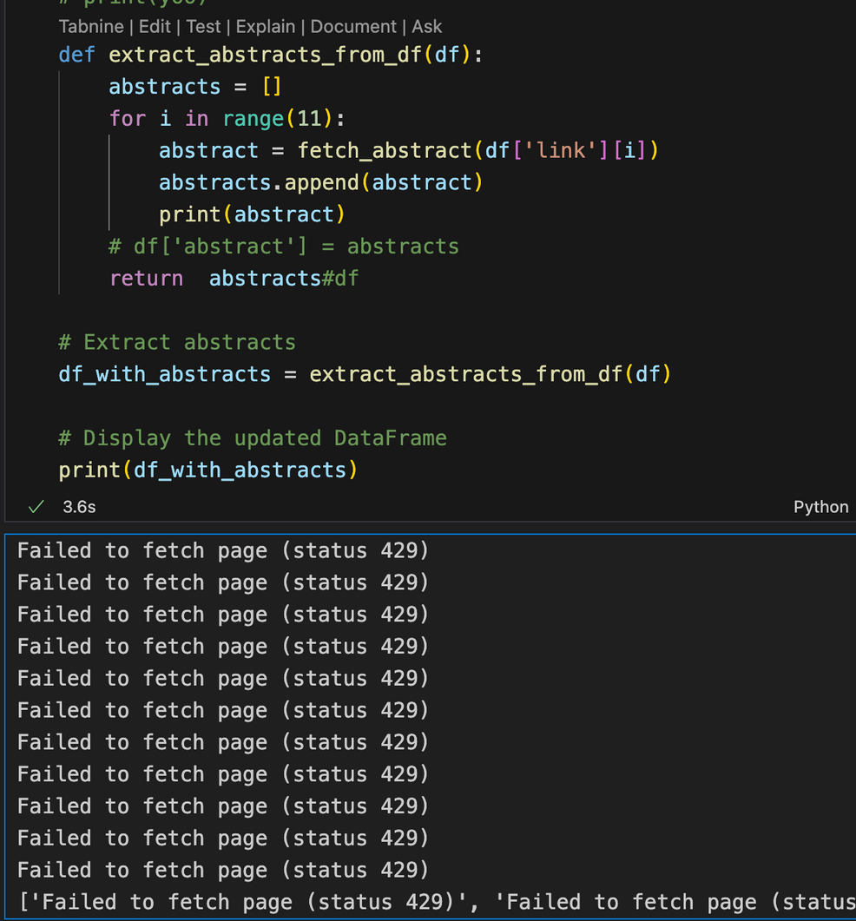
CHALLENGES
unable to access the page
more than 2 hr run time!

Slide 11
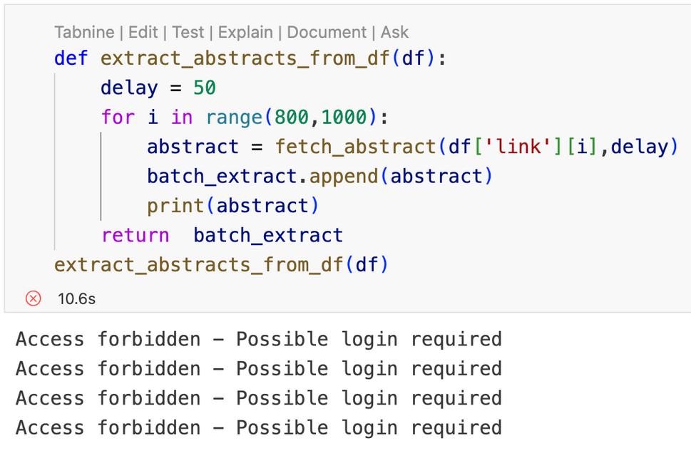
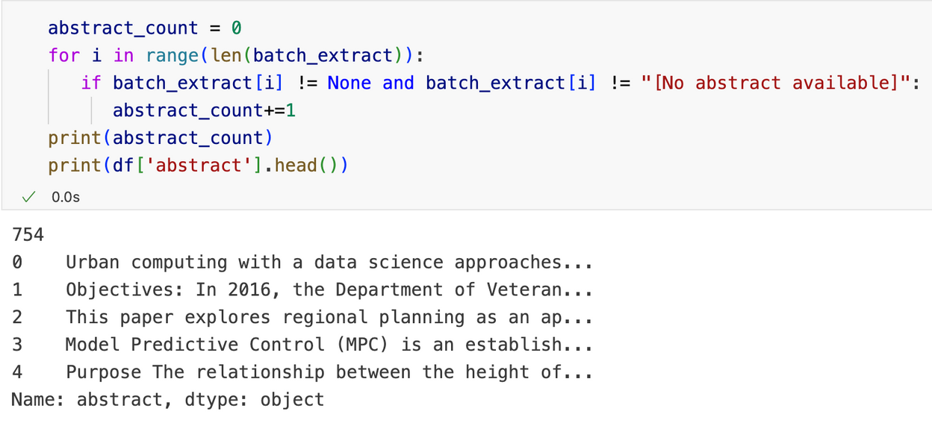
CHALLENGES
403 error
more than 700 abstract is retrieved

Slide 12
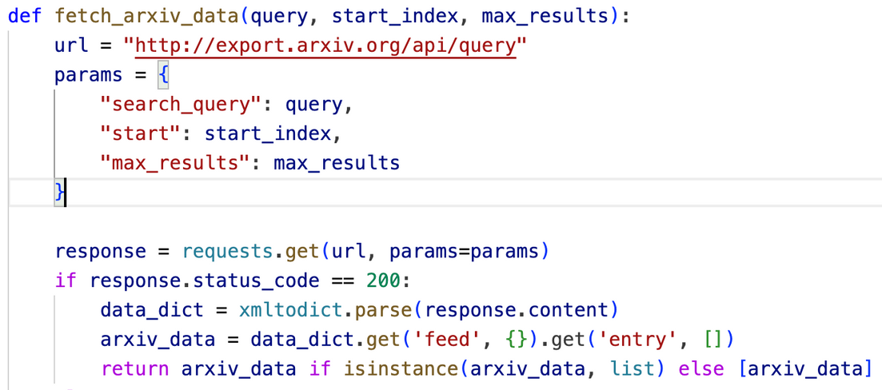
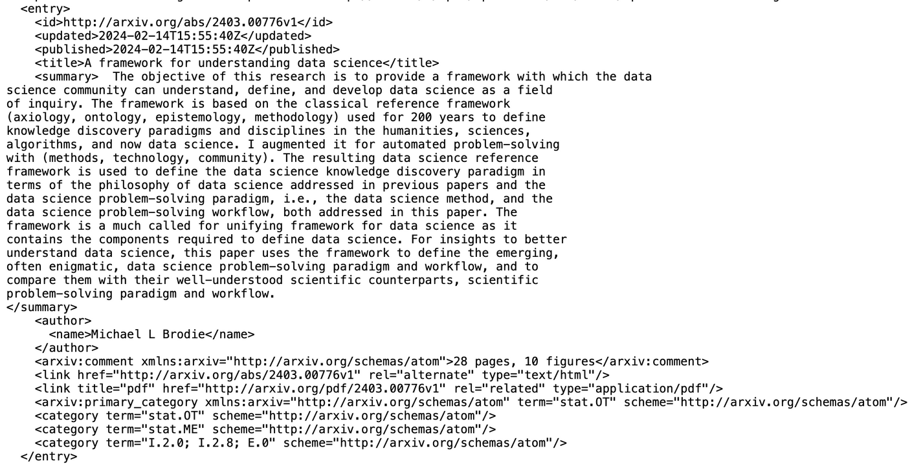
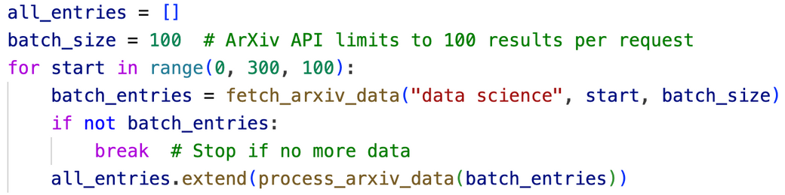
ARXIV API
additional 300 papers

Slide 13
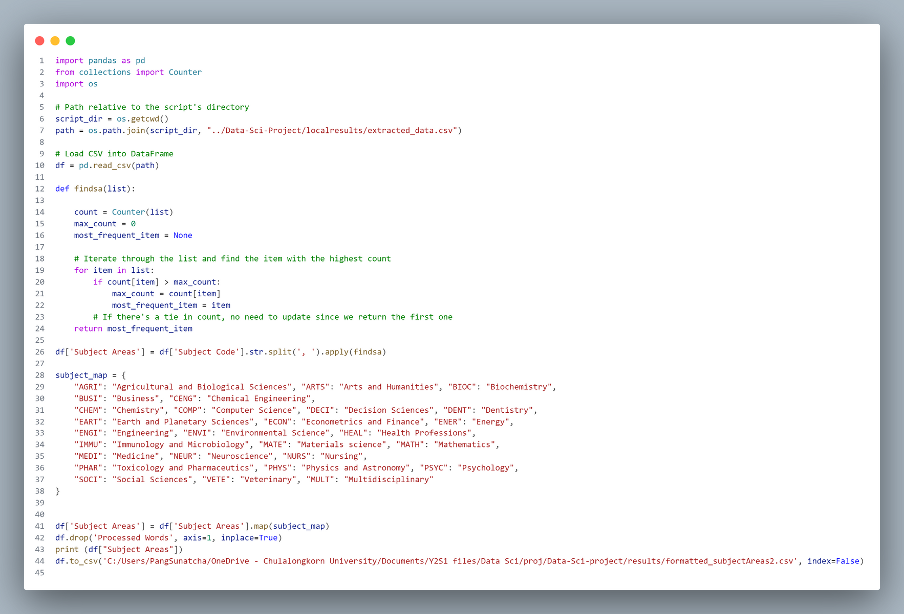
DATA PREP AND ML
format subject area to focus only on the first most relevant subject area of each book for simpler classification and use map to convert the subject codes into actual subject name
Notes:
we first formatted the subject area column which had multiple and duplicate subject areas per book into a single subject area to focus only on the first most relevant subject area for each book in order to achieve simpler classification of the data
and then use map to convert the subject area's 4-letter codes into actual subject names for better understanding in future data usages

Slide 14
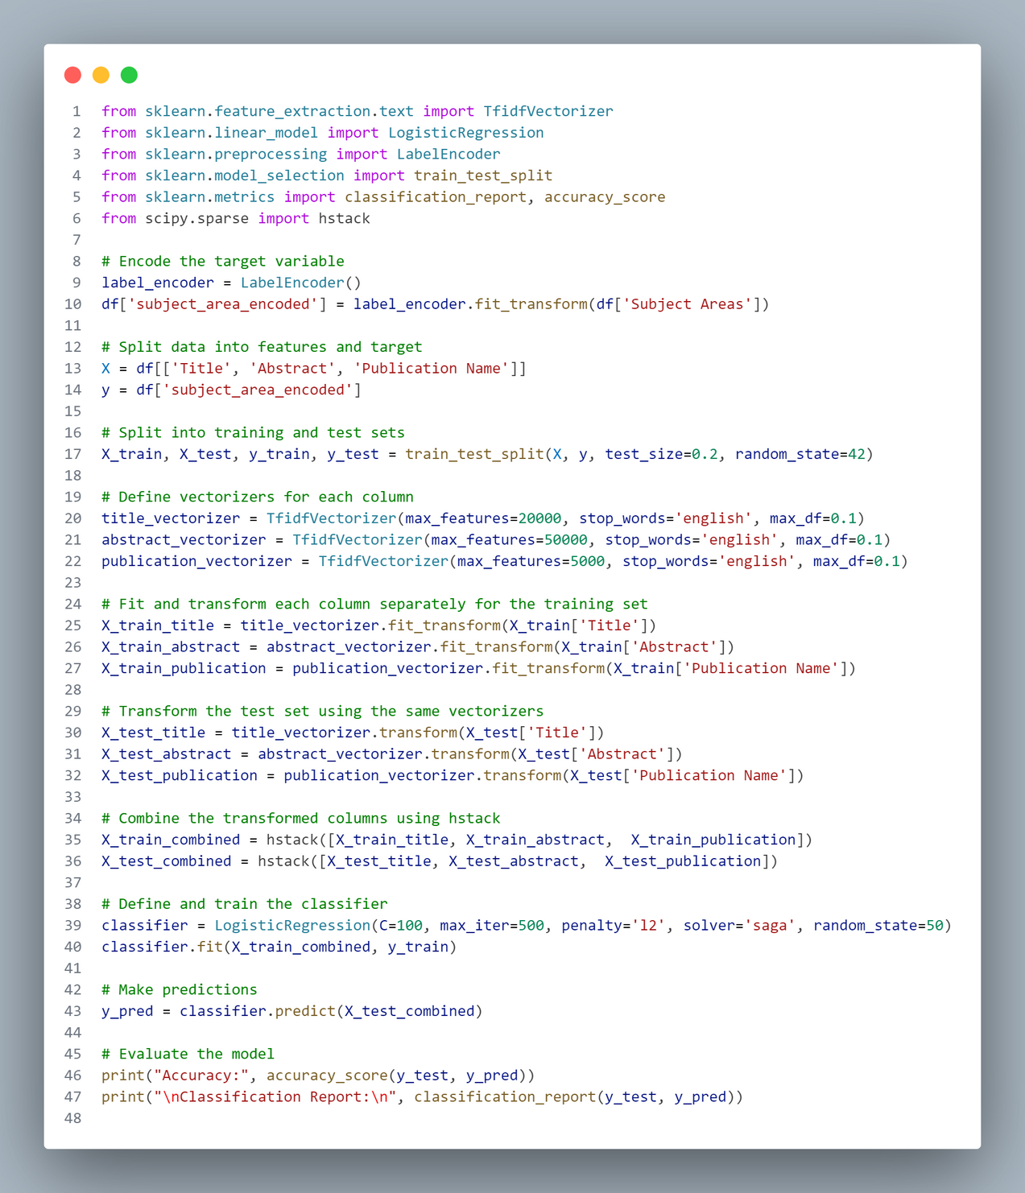
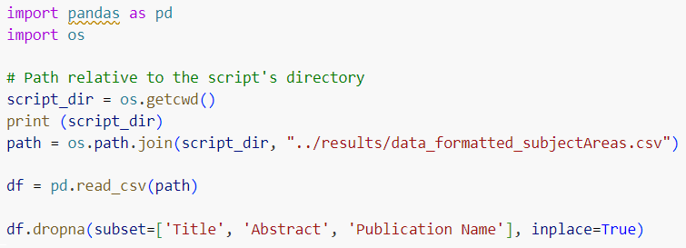
DATA PREP AND ML
use AI to predict Subject Area by training model with the given data
drop rows with missing values needed for ml
used “TF-IDF” (Term Frequency-Inverse Document Frequency) to classify words in Title, Abstract, Publication Name and remove English Stop Words.
fit and predict with Logistic Regression
yield final accuracy of 0.88
Notes:
In using AI to predict missing Subject Areas in data fetched from api,
we trained and tested the model with the given data of around 20,000 data points
firstly, we drop rows with missing values needed for ml which are title , abstract, and publication name. and we are now left with around 16,000 data points for model training
the we used “TF-IDF” (Term Frequency-Inverse Document Frequency) to classify words in Title, Abstract, Publication Name and set its parameter to remove English Stop Words.
we also set the max_features parameter to be high to capture all important words across the data and set the max_df to be low since we don't want words that appear too often across the dataset to have influence on the prediction and these words may not be in english stop words but may be common academic terms that holds no significance in subject area predictions
finally, we combined all the vectorised columns with hstack to fit to logistic regression ai model and test its prediction on subject area
after various trials of tuning the parameters and models we yield final accuracy of 0.88

Slide 15
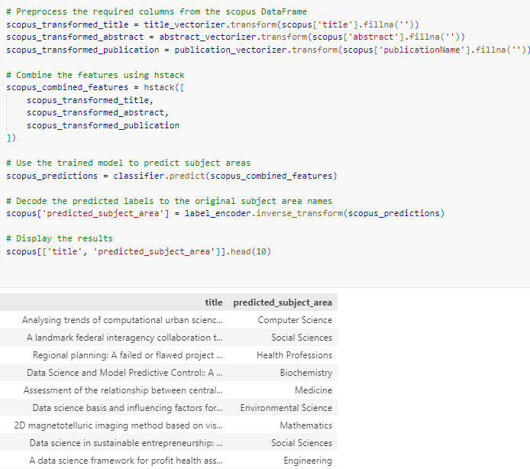
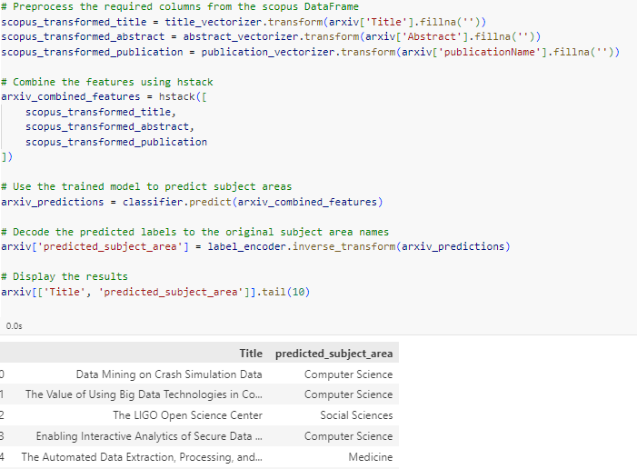
we dropped the scopus api data where abstract cannot be fetched and predicted the subject areas for each dataset separately using the same trained model
DATA PREP AND ML
scopus
arxiv
Notes:
now our model is ready to pridict subject areas from api fetched data.
we dropped the scopus api data rows where abstract cannot be fetched
then we predicted the subject areas for each api dataset separately using the previously trained model. the code and prediction preview of scopus api can be seen on the left and arxiv can be seen on the right of the slide
surprisingly, there are more inaccurate predictions than expected. Most of the subject areas should be predicted as “Computer Science” since our api query is Data science but only around half of the data is labeled so. this is because tfidf scores importance of word when it appears less across the whole document but ‘data’ and science are very common word among abstracts in many subject areas. which resulted in lower importance and contribution to the prediction model.

Slide 16
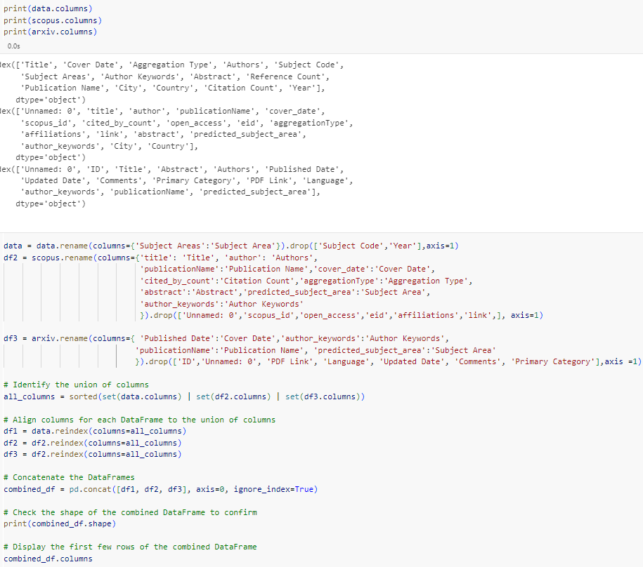
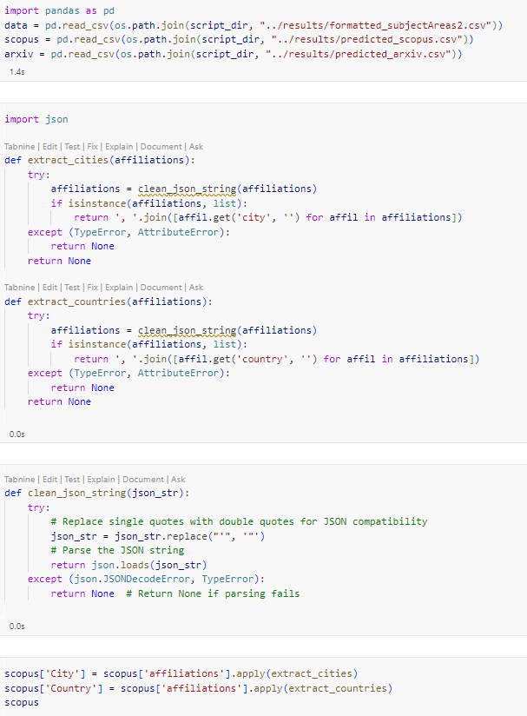
final data preparation for visualization
DATA PREP AND ML
formatted City and Country by extracting from affiliations column in scopus api dataset
rename columns from the given data, scopus api data, and arxiv api data to match and drop unused columns then join all datasets together
Notes:
finally, we prepared the data for visualization. this includes some further data extraction of City and Country from the affiliatoin column in scopus api data with json string formatting.
we then renamed and set all the columns across each of the 3 datasets to match. which are the given data, scopus api data, and arxiv api data and dropped unused columns in each dataset
lastly, we joined all the data together using pd.concat

Slide 17
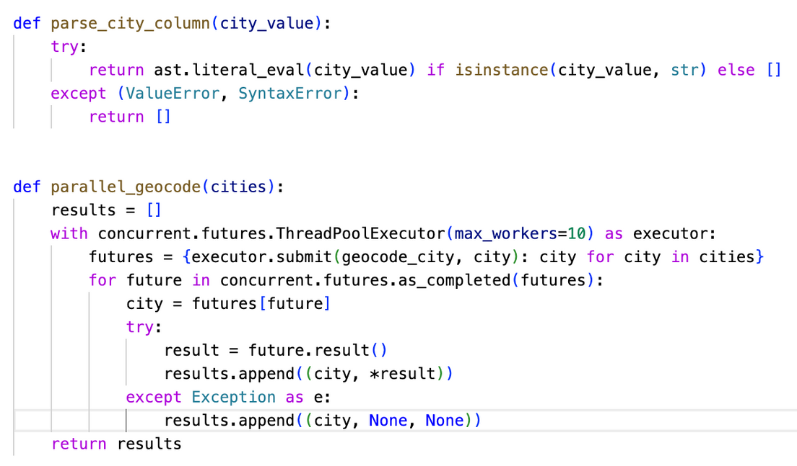
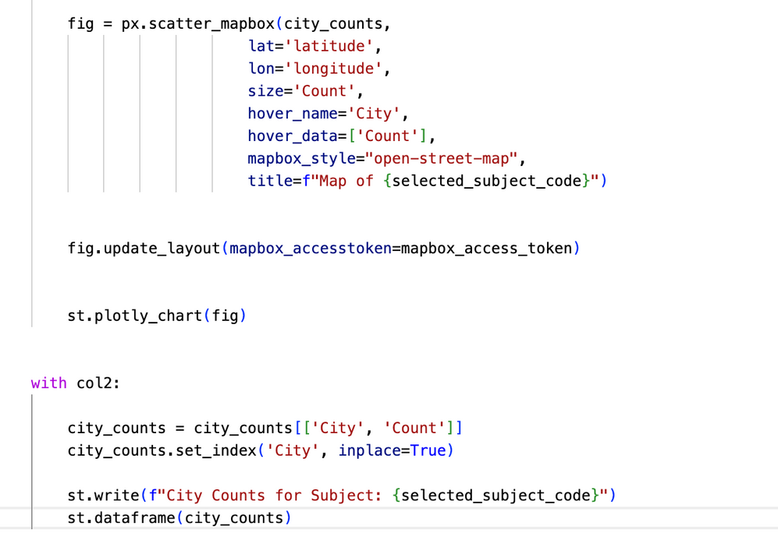
VISUALIZE
convert city into geographical coordinates
using Plotly and Streamlit to display map and data

Slide 18
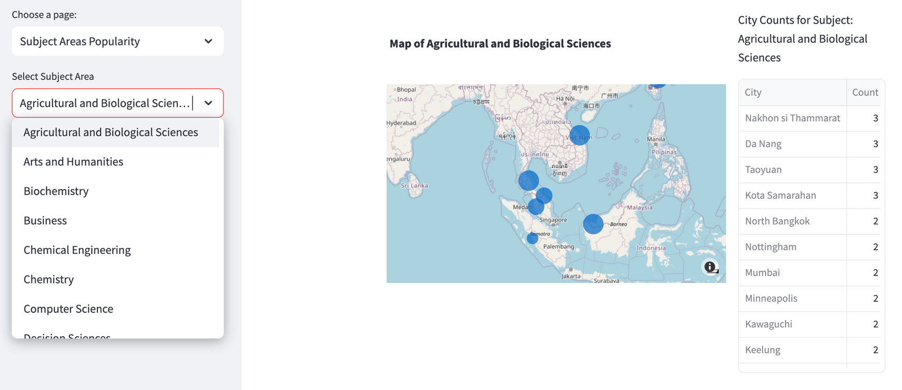
MAP

Slide 19

THANK YOU!

